Slide 1

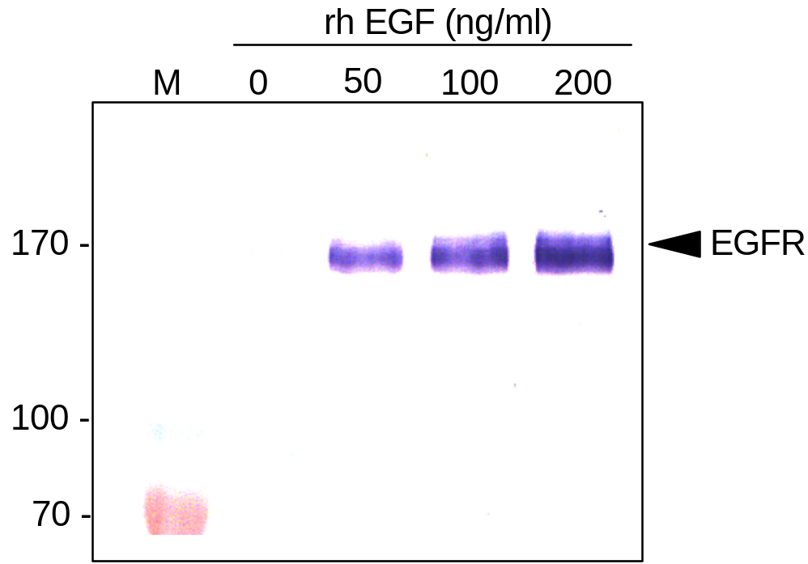
ReliaTech GmbH
Biological activity of recombinant human EGF (E. coli)
(Cat #100-09; Lot# 1404R24 [lyo]; A431 Assay)
Figure 1. EGF-induced phosphorylation of EGFR in the A431 tumor cell line.
(Soler et al, J Chromatography B, 788,113, 2003)
http://www.reliatech.de / info@reliatech.de

